Slide 1


Sarvajanik College of Engineering & Technology
Subject: Analysis and Design of Algorithms (2150703)
Topic: BFS and its application
Branch: Computer Engineering (Shift - 1)
Semester: 5
Submitted to: Prof. Mistry Urvashi M.
Dr. Mayuri Mehta
Prepared By: Darshit Akbari 160420107002
Amul Luniya 160420107003
Abhishek Chavda 160420107009
Tejas Khunt 160420107023
Keval Navadiya 160420107031

Slide 2
BFS and its Application

Slide 3
Contents
Introduction to BFS
Algorithm
Example
Analysis
Application

Slide 4
BFS – Breadth First Search
Breadth first search is a general technique for traversing a graph.
Breadth first search is one of the simplest algorithms for searching a graph and the archetype for many important graph algorithms.
Breadth first search start several paths at a time, and advance in each one step at a time.

Slide 5
Breadth First Search
Breadth first search starts at a given vertex s.
In the first stage, we visit all the vertices that are at the distance of one edge away. When we visit there, we paint it as “visited”, the vertices adjacent to the start vertex.
In the second stage, we visit all the new vertices we can reach at the distance of two edges away from the source vertex s. These new vertices are placed ahead, and so on.
The BFS traversal terminates when every vertex are been visited.

Slide 6
Breadth First Search
The breadth-first-search procedure BFS below assumes that the input graph G = (V, E) is represented using adjacency lists.
It attaches several additional attributes to each vertex in the graph.
We store the color of each vertex u ϵ V in the attribute u.color and the predecessor of u in the attribute u.π.
If u has no predecessor (for example, if u = s or u has not been discovered), then u.π = NULL.
The attribute u.d holds the distance from the source s to vertex u computed by the algorithm.

Slide 7
BFS Algorithm
BFS (G, s)
for each vertex u ϵ G.V – {s}
u.color = WHITE
U.d = ∞
U.π = NIL
s.color = GRAY
s.d = 0
s.π = NULL
Q = Φ ;
ENQUEUE (Q , s)
while Q ≠ Φ ;
u = DEQUEUE (Q)
for each v ϵ G.Adj[u]
if v.color = = WHITE
v.color = GRAY
v.d = u.d + 1
v.π = u
ENQUEUE (Q, v)
U.color = BLACK

Slide 8
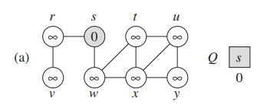
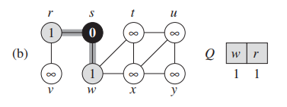
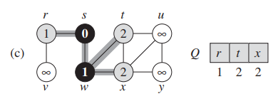
Example

Slide 9
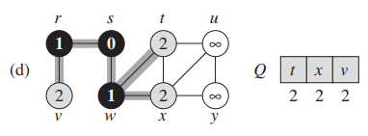
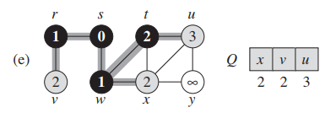
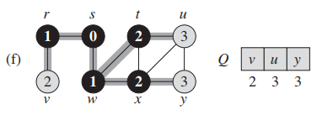
Example

Slide 10
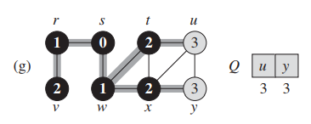
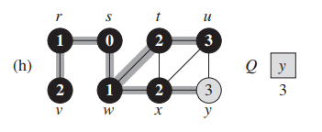
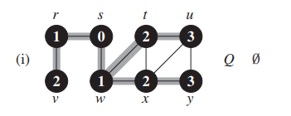
Example

Slide 11
Analysis
Set a vertex/edge label takes O(1) time
Each vertex is labeled twice
once as UNEXPLORED
once as VISITED
Each edge is labeled twice
once as UNEXPLORED
once as DISCOVERY or CROSS

Slide 12
Analysis
Each vertex is inserted once into a sequence Q
Method incident Edges is called once for each vertex
BFS runs in O(V + E) time provided the graph is represented by the adjacency list structure

Slide 13
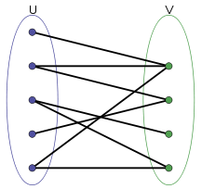
Applications of BFS
Finding all nodes within one connected component:
We use Breadth First to find all nodes reachable from a given node.
To test if a graph is Bipartite

Slide 14
Applications of BFS
Shortest Path and Minimum Spanning Tree for unweighted graph
In an unweighted graph, the shortest path is the path with least number of edges. With Breadth First, we always reach a vertex from given source using the minimum number of edges. Also, in case of unweighted graphs, any spanning tree is Minimum Spanning Tree and we can use either Depth or Breadth first traversal for finding a spanning tree.

Slide 15
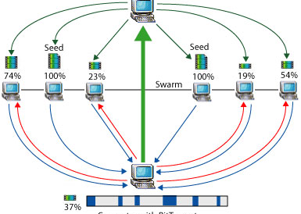
Applications of BFS
Peer to Peer Networks.
In Peer to Peer Networks like BitTorrent, Breadth First Search is used to find all neighbour nodes.

Slide 16
Applications of BFS
Crawlers in Search Engines:
Crawlers build index using Breadth First. The idea is to start from source page and follow all links from source and keep doing same. Depth First Traversal can also be used for crawlers, but the advantage with Breadth First Traversal is, depth or levels of the built tree can be limited.
Social Networking Websites:
In social networks, we can find people within a given distance ‘k’ from a person using Breadth First Search till ‘k’ levels.

Slide 17
Applications of BFS
Broadcasting in Network:
In networks, a broadcasted packet follows Breadth First Search to reach all nodes.
GPS Navigation systems:
Breadth First Search is used to find all neighbouring locations.

Slide 18
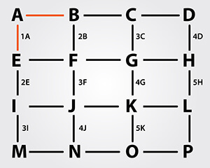
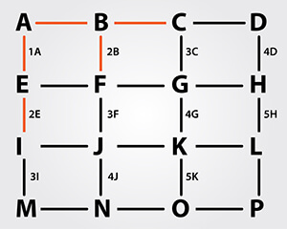
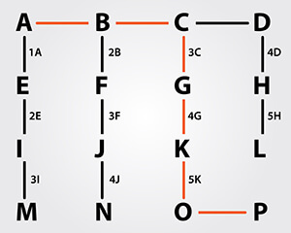
Application in GPS

Slide 19
References
www.hackerearth.com/blog/algorithms/breadth-first-search-bfs-algorithm-example-gps-navigation/
www.geeksforgeeks.org/applications-of-breadth-first-traversal/
Cormen, Thomas H.; Leiserson, Charles E.; Rivest, Ronald L.; Stein, Clifford (2001) [1990]. "22.2 Breadth-first search". Introduction to Algorithms (2nd ed.). ISBN 0-262-03293-7.

Slide 20
THANK YOU

